Slide 1
Time and Space Complexity

Slide 2
Learning Objectives
After this video and practice problems, you should be able to...
Describe the difference between Code Modeling and Asymptotic Analysis (both components of Algorithmic Analysis)
Model a (simple) piece of code with a function describing its runtime
Explain why we can throw away constants when we compute Big-O bounds.
From a practical perspective and from the “definition” perspective.

Slide 3
Lecture Outline
Overview: Algorithmic Analysis
Code Modeling
Asymptotic Analysis
Big-O Definition

Slide 4
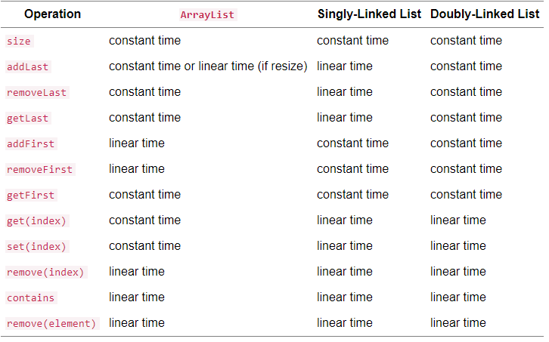
Time and space analysis helps us differentiate between data structures
ArrayList
Zero “overhead” per element (internal array just stores the data)
But extra capacity is “wasted”
Linked List
One or two extra references per element (next and previous in each node)
But exactly as many nodes as elements (no extra capacity)
If ArrayList is managed precisely will be more space efficient, but both structures take linear space
“Just change first node” vs. “Change every element” is clearly different
To evaluate data structures, need to understand impact of design decisions

Slide 5
We need a tool to analyze code that is
A
Simple
We don’t care about tiny differences in implementation, want the big picture result
B
Mathematically Rigorous
Use mathematical functions as a precise, flexible basis
Decisive
Produce a clear comparison indicating which code takes “longer”
C

Slide 6
Overview: Algorithmic Analysis
1
2
CODE
RUNTIME
FUNCTION
COMPLEXITY
CLASS
Code Modeling
©
Asymptotic Analysis
for (i = 0; i < n; i++) {
a[i] = 1;
b[i] = 2;
}
f(n) = 2n
O(n)
Algorithmic Analysis: The overall process of characterizing code with a complexity class, consisting of:
Code Modeling: Code → Function describing code’s runtime
Asymptotic Analysis: Function → Complexity class describing asymptotic behavior
Notes:
Today, brief (1) then mostly (2)
Wednesday, more detail on (1)

Slide 7
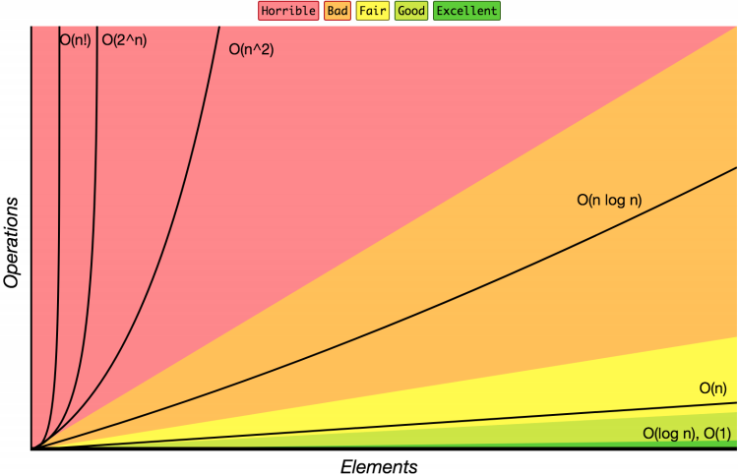
What is a Complexity Class
Complexity Class: a category of algorithm efficiency based on the algorithm’s relationship to the input size N
Complexity Class | Big-O | Runtime if you double N
constant | O(1) | unchanged
logarithmic | O(log₂ N) | increases slightly
linear | O(N) | doubles
log-linear | O(N log₂ N) | slightly more than doubles
quadratic | O(N²) | quadruples
... | ... | ...
exponential | O(2^{N}) | multiplies drastically

Slide 8
Does Complexity Really Matter?
Yes! The following table presents several hypothetical algorithm runtimes as an input size N grows, assuming that each algorithm required 100ms to process 100 elements. Notice that even if they all start at the same runtime for a small input size, the ones in higher complexity classes become so slow as to be impractical.

Slide 9
Lecture Outline
Overview: Algorithmic Analysis
Code Modeling
Asymptotic Analysis
Big-O Definition

Slide 10
Code Modeling
1
CODE
RUNTIME
FUNCTION
Code Modeling
Code Modeling – the process of mathematically representing how many operations a piece of code will perform in relation to the input size n.
Convert from code to a function representing its runtime

Slide 11
What is an operation?
We don’t know exact time every operation takes, but for now let’s try simplifying assumption: all basic operations take the same time
Basics:
+, -, /, *, %, ==
Assignment
Returning
Variable/array access
Function Calls
Total time from the operations in the code for that function
Conditionals
Test + time for the followed branch
Loops
Number of iterations * total time for the condition and code inside the loop

Slide 12
Code Modeling Example I
public void method1(int n) {
int sum = 0;
int i = 0;
while (i < n) {
sum = sum + (i * 3);
i = i + 1;
}
return sum;
}
+1
+1
+1
Loop runs n times
+3
+6
*n
+2
+1
f(n) = 6n + 3

Slide 13
Code Modeling Example II
public void method2(int n) {
int sum = 0;
int i = 0;
while (i < n) {
int j = 0;
while (j < n) {
if (j % 2 == 0) {
// do nothing
}
sum = sum + (i * 3) + j;
j = j + 1;
}
i = i + 1;
} return sum;
}
+1
+1
+1
+1
+1
This outer loop
runs n times
This inner loop
runs n times
+2
9n + 4
*n
+9
*n
+4
+2
+2
f(n) = (9n+4)n + 3
+1

Slide 14
Lecture Outline
Overview: Algorithmic Analysis
Code Modeling
Asymptotic Analysis
Big-O Definition

Slide 15
Where are we?
1
2
CODE
RUNTIME
FUNCTION
COMPLEXITY
CLASS
Code Modeling
Asymptotic Analysis
for (i = 0; i < n; i++) {
a[i] = 1;
b[i] = 2;
}
f(n) = 2n
O(n)
We just turned a piece of code into a function!
Now to focus on step 2, asymptotic analysis

Slide 16
Finding a Big-O
2
RUNTIME
FUNCTION
COMPLEXITY
CLASS
Asymptotic Analysis
We have an expression for $f(n)$. How do we get the $O()$ that we’ve been talking about?
1. Find the “dominating term” and delete all others.
The “dominating” term is the one that is largest as $n$ gets bigger. In this class, often the largest power of $n$.
2. Remove any constant factors.
f(n) = (9n+4)n + 3
= 9n² + 4n + 3
≈ 9n²
≈ n²
f(n) is O(n²)
Notes:
Asymptotic Analysis works for any function

Slide 17
Is it okay to throw away all that info?
Asymptotic Analysis: Analysis of function behavior as its input approaches infinity
We only care about what happens when n approaches infinity
For small inputs, doesn’t really matter: all code is “fast enough”
Since we’re dealing with infinity, constants and lower-order terms don’t meaningfully add to the final result. The highest-order term is what drives growth!
Remember our goals:
A
Simple
We don’t care about tiny differences in implementation, want the big picture result
Decisive
Produce a clear comparison indicating which code takes “longer”
C

Slide 18
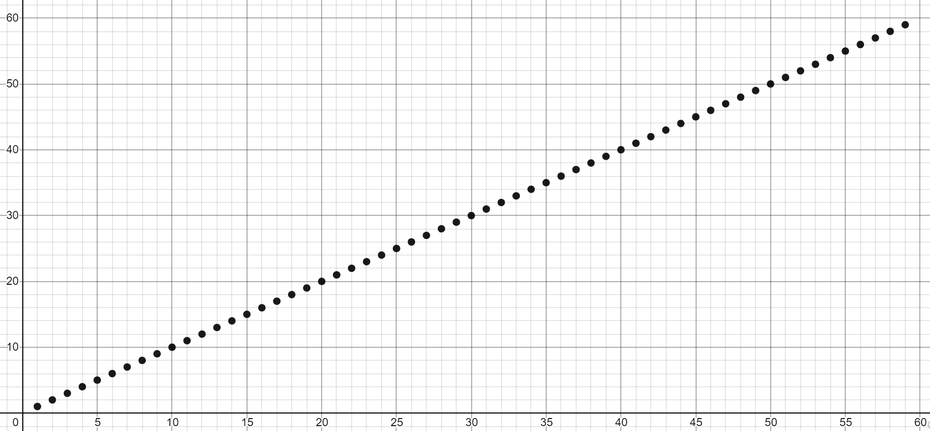
No seriously, this is really okay?
There are tiny variations in these functions (2n vs. 3n vs. 3n+1)
But at infinity, will be clearly grouped together
We care about which group a function belongs in
Let’s convince ourselves this is the right thing to do:
https://www.desmos.com/calculator/t9qvn56yyb

Slide 19
What is an operation, again?
We could try being more precise, and count up individual operations
Then, sum the time each operation takes
But how long do they take? Some architectures are really fast at +, others faster at assignment
And when we compile it, our code gets expressed as lower-level operations anyway! It’s almost impossible to stare at code and know the “true” constants.
public void method1(int n) {
int sum = 0;
int i = 0;
while (i < n) {
sum = sum + (i * 3);
i = i + 1;
}
return sum;
}
Operation | Count
Assignment | 2 + 2n
< | n
+ | 2n
* | n
Return | 1
public static void method1(int[]); Code:
0: iconst_0
1: istore_1
2: iconst_0
3: istore_2
4: iload_2
5: iload_0
6: if_icmpge 22
9: iload_1
10: iload_2
11: iconst_3
12: imul
13: iadd
14: istore_1
15: iload_2
16: iconst_1
17: iadd
18: istore_2
19: goto 4
22: iload_1
23: ireturn

Slide 20
Code Modeling Anticipating Asymptotic Analysis
We can’t accurately model the constant factors just by staring at the code.
And the lower-order terms matter even less than the constant factors.
Since they’re going to be thrown away anyway, you can anticipate which constants are unnecessary to count precisely during Code Modeling
e.g. a loop body containing a constant 2 vs. 10 operations is unimportant here
This does not mean you shouldn’t care about constant factors ever – they are important in real code!
Asymptotic analysis is just one tool, but other perspectives that do consider constants are also valid and useful!

Slide 21
Lecture Outline
Overview: Algorithmic Analysis
Code Modeling
Asymptotic Analysis
Big-O Definition

Slide 22
Using Formal Definitions
If analyzing simple or familiar functions, don’t bother with the formal definition. You can be comfortable using your intuition!
If you take more CS classes (202, 252, 254) the formal definition will be important, so I wanted to mention it here
B
Mathematically Rigorous
Use mathematical functions as a precise, flexible basis

Slide 23
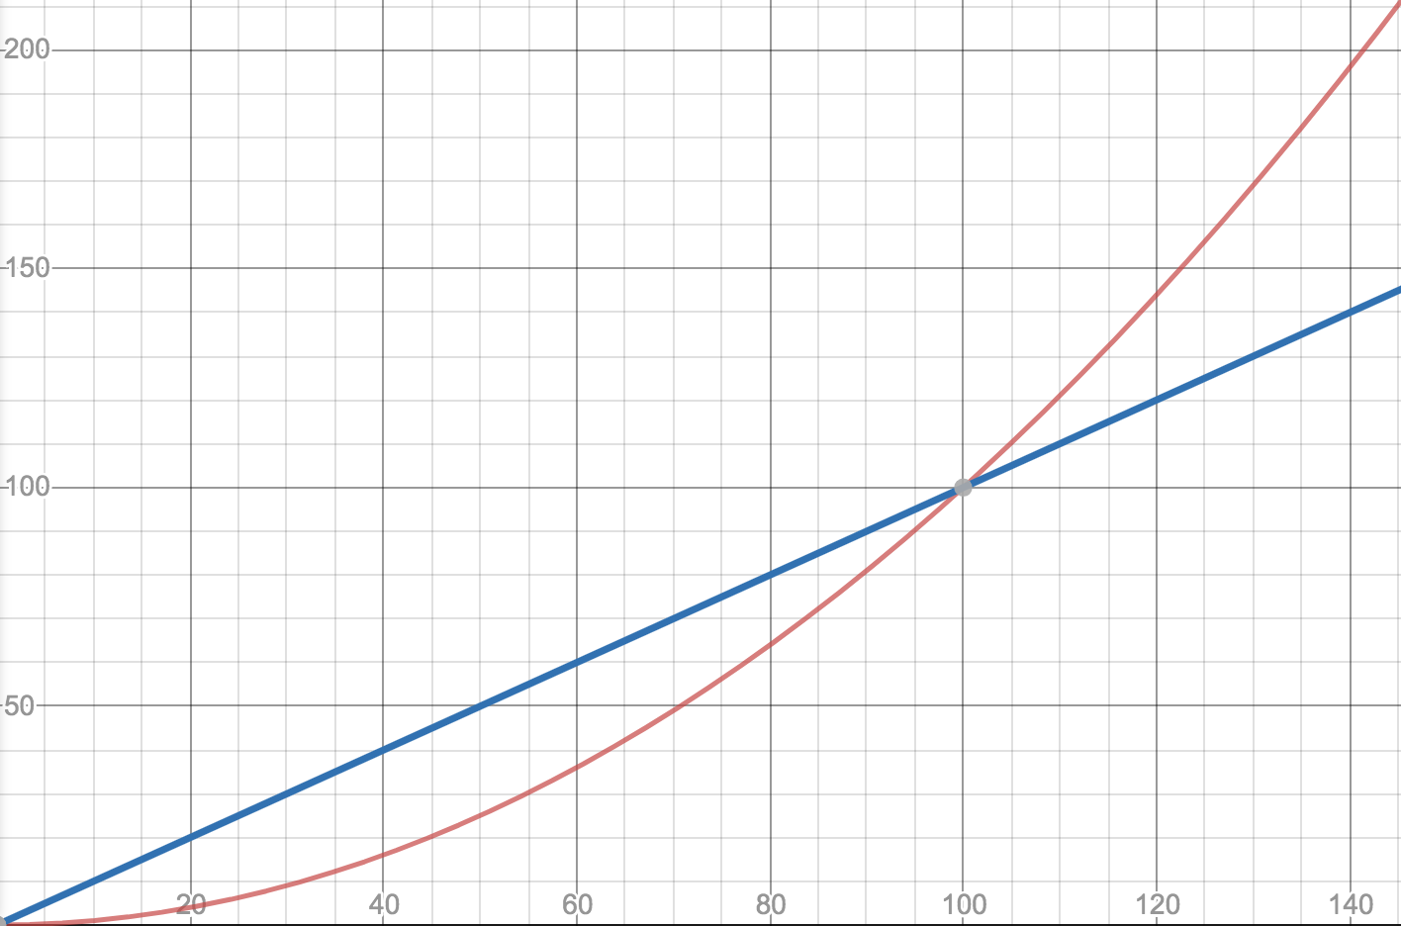
Big-O Definition
Why $n_{0}$?
f1(n)=0.01n²
We wanted to find an upper bound on our algorithm’s running time, but
We only care about what happens as $n$ gets large.
We don’t want to care about constant factors.
f2(n)=n
$f(n)$ is $O(g\left(n\right))$ if there exist positive constants $c, n_{0}$ such that for all $n≥n_{0}$,
$$f\left(n\right)≤c⋅g\left(n\right)$$
Big-O
Why $c$?
$$T\left(n\right)$$
Intuition: $g\left(n\right)$ “eventually dominates” $f(n)$
f(n)=5n
$$n$$
g(n)=n

Slide 24
Big-O Proofs
$f(n)$ is $O(g\left(n\right))$ if there exist positive constants $c, n_{0}$ such that for all $n≥n_{0}$,
$$f\left(n\right)≤c⋅g\left(n\right)$$
Big-O
Show that
$$f\left(n\right)=10n+15$$
is
$O\left(n\right)$.
Apply definition term by term
$10n≤c・n when c=10 for all values of n. So 10n≤10n$, for all $n$
$15≤c・n when c=15 for n≥1.$ $So 15≤15n$, when $n≥1$
Add up all your truths
$$10n+15≤10n+15n=25n for n≥1$$
10n + 15 <= 25n for n >= 1.
which is in the form of the definition
f(n) <= c * g(n)
where c = 25 and n₀ = 1.

Slide 25
Big-O Doesn’t Have to be Tight
True or False: $10n^{2}$ is $O(n^{3})$
It’s true – it fits the definition
n⁵
$$10n2≤c・n3 when c=10 for n≥1$$
n⁴
$$T\left(n\right)$$
Big-O is just an upper bound that may be loose and not describe the function fully. For example, all of the following are true:
$10n^{2}$is $O(n^{3})$
$10n^{2}$is $O\left(n^{4}\right)$
$10n^{2}$is $O\left(n^{5}\right)$
$10n^{2}$is $O(n^{n})$
$10n^{2}$is $O(n!)$ … and so on
n³
10n²
$$n$$

Slide 26
Uncharted Waters: Prime Checking
Find a model $f\left(n\right)$ for the running time of this code on input $n →$ What’s the Big-O?
We know how to count the operations
But how many times does this loop run?
Sometimes it can stop early
Sometimes it needs to run n times
boolean isPrime(int n) {
int toTest = 2;
while(toTest < n) {
if (n % toTest == 0) {
return false;
} else {
toTest += 1;
}
}
return true;
}
+1
+1
+2
+1
~+5
*?
+2
+1

Slide 27
Prime Checking Runtime
$$f(n)$$
Is the running time of the code $O\left(1\right)$ or $O\left(n\right)?$
More than half the time we need 3 or fewer iterations. Is it $O(1)$?
But there’s still always another number where the code takes $n$ iterations. So $O\left(n\right)?$
This is why we have definitions!

Slide 28
$f(n)$ is $O(g\left(n\right))$ if there exist positive constants $c, n_{0}$ such that for all $n≥n_{0}$,
$$f\left(n\right)≤c⋅g\left(n\right)$$
Big-O
$$f(n)$$
Is the running time $O(n)$?
Can you find constants $c$ and $n_{0}$?
How about $c=1$ and $n_{0}=5$,
$f\left(n\right)=$smallest divisor of $n≤1⋅n$ for $n≥5$
Is the running time $O(1)$?
Can you find constants $c$ and $n_{0}$?
No! Choose your value of $c$. I can find a prime number $k$bigger than $c.$
And $f\left(k\right)=k>c⋅1$ so the definition isn’t met!
It’s $O(n)$ but not $O\left(1\right)$

Slide 29
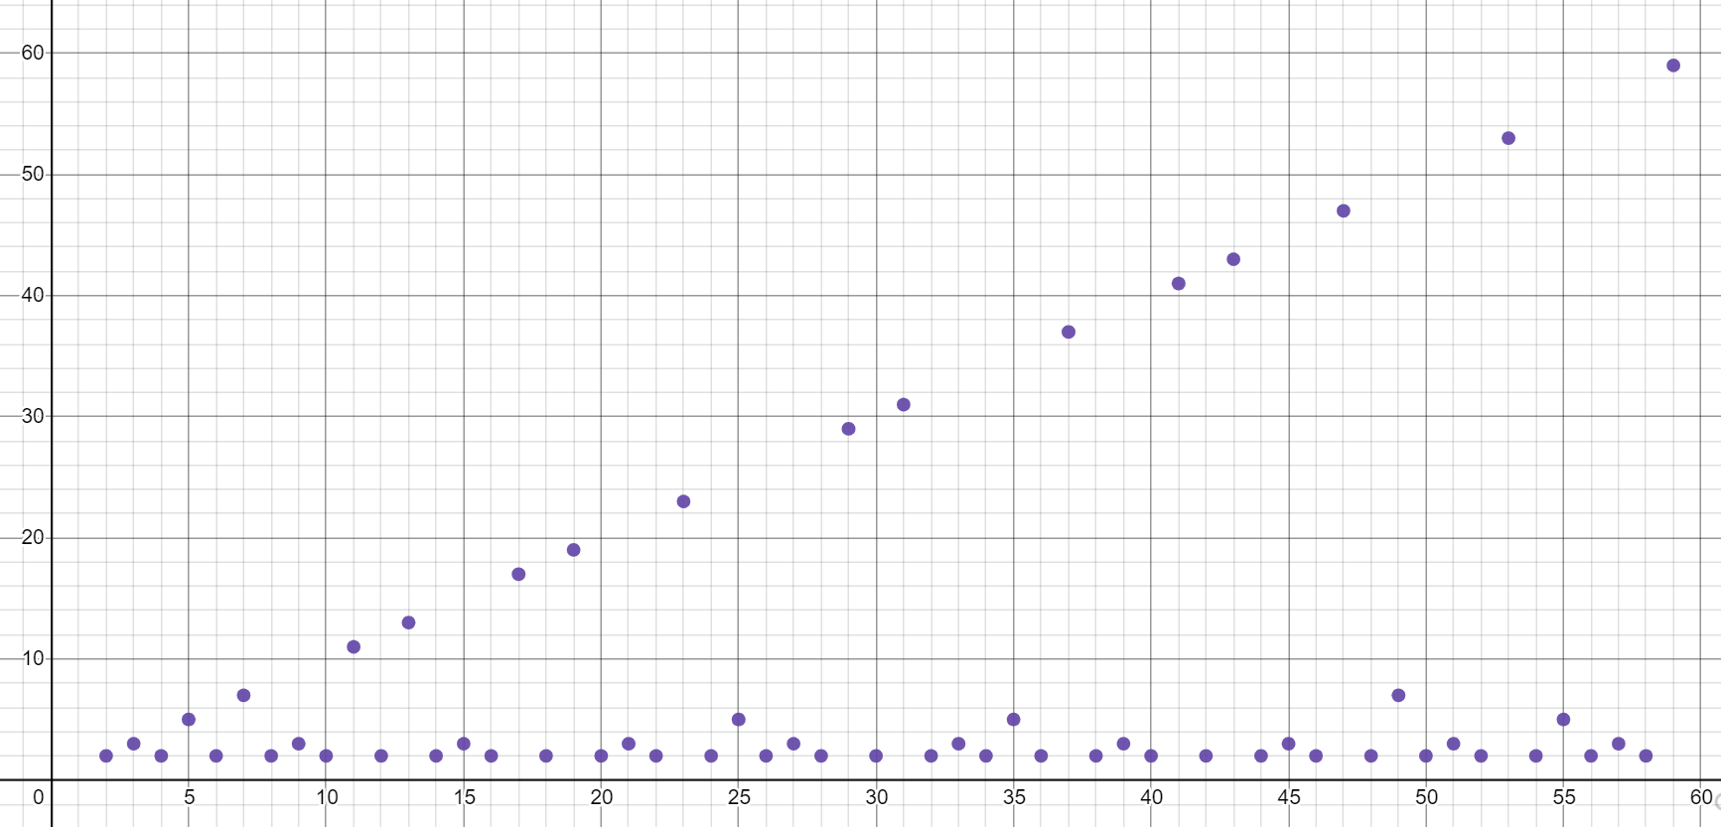
Big-Oh isn’t everything
Our prime finding code is $O\left(n\right)$as tight bound. But so is printing all the elements of a list.
$$O(n)$$
$$O(n)$$
Your experience running these two pieces of code is going to be very different.
It’s disappointing that the $O()$ are the same – that’s not very precise.
Could we have some way of pointing out the list code always takes AT LEAST $n$ operations?

Slide 30
Big-$Ω$ [Omega]
$f(n)$ is $Ω(g\left(n\right))$ if there exist positive constants $c, n_{0}$ such that for all $n≥n_{0}$,
$$f\left(n\right)≥c⋅g\left(n\right)$$
Big-Omega
$f(n)$ is $O(g\left(n\right))$ if there exist positive constants $c, n_{0}$ such that for all $n≥n_{0}$,
$$f\left(n\right)≤c⋅g\left(n\right)$$
Big-O
The formal definition of Big-Omega is the flipped version of Big-Oh!
“f(n) is O(g(n))” : f(n) grows at most as fast as g(n)
“f(n) is $Ω$(g(n))” : f(n) grows at least as fast as g(n)
$$O(n)$$
$$Ω(1)$$

Slide 31
Big-Omega Also Doesn’t Have to be Tight
2n³
$2n^{3} is Ω($1)
${2n}^{3} is Ω(n$)
$2n^{3} is Ω(n^{2})$
${2n}^{3} is Ω(n^{3})$
$2n^{3} is lowerbounded by all the complexity classes listed above (1, n,n^{2},n^{3})$
$$T\left(n\right)$$
n³
n²
n
1
$$n$$

Slide 32
Examples
$f(n)$ $∈$ $O(g\left(n\right))$ if there exist positive constants $c, n_{0}$ such that for all $n≥n_{0}$,
$$f\left(n\right)≤c⋅g\left(n\right)$$
Big-O
4n² ∈ O(1)
false
4n² ∈ O(n)
false
4n² ∈ O(n²)
true
4n² ∈ O(n³)
true
4n² ∈ O(n⁴)
true
4n² ∈ Ω(1)
true
4n² ∈ Ω(n)
true
4n² ∈ Ω(n²)
true
4n² ∈ Ω(n³)
false
4n² ∈ Ω(n⁴)
false
$f(n)$ $∈ Ω(g\left(n\right))$ if there exist positive constants $c, n_{0}$ such that for all $n≥n_{0}$,
$$f\left(n\right)≥c⋅g\left(n\right)$$
Big-Omega

Slide 33
Tight Big-O and Big-$Ω$ Bounds Together
prime runtime function
f(n) = n
$$O(n)$$
$$O(n)$$
$Ω$(1)
$Ω$(n)
Note: most functions look like the one on the right, with the same tight Big-Oh and Big-Omega bound. But we’ll see important examples of the one on the left.

Slide 34
Oh, and Omega, and Theta, oh my
$f(n)$ is $O(g\left(n\right))$ if there exist positive constants $c, n_{0}$ such that for all $n≥n_{0}$,
$$f\left(n\right)≤c⋅g\left(n\right)$$
Big-Oh
Big-Oh is an upper bound
My code takes at most this long to run
Big-Omega is a lower bound
My code takes at least this long to run
Big Theta is “equal to”
My code takes “exactly”* this long to run
*Except for constant factors and lower order terms
Only exists when Big-Oh == Big-Omega!
$f(n)$ is $Ω(g\left(n\right))$ if there exist positive constants $c, n_{0}$ such that for all $n≥n_{0}$,
$$f\left(n\right)≥c⋅g\left(n\right)$$
Big-Omega
Big-Theta
$f(n)$ is $Θ(g\left(n\right))$ if
$f\left(n\right)$ is $O(g\left(n\right))$ and $f\left(n\right)$ is $Ω(g\left(n\right))$.
(in other words: there exist positive constants $c1, c2, n_{0}$ such that for all $n≥n_{0}$)
$c1⋅g\left(n\right)≤f\left(n\right)$ $≤c2⋅g\left(n\right)$

Slide 35
O, and Omega, and Theta [oh my?]
Big-Theta
Big Theta is “equal to”
My code takes “exactly”* this long to run
*Except for constant factors and lower order terms
$f(n)$ is $Θ(g\left(n\right))$ if
$f\left(n\right)$ is $O(g\left(n\right))$ and $f\left(n\right)$ is $Ω(g\left(n\right))$.
(in other words: there exist positive constants $c1, c2, n_{0}$ such that for all $n≥n_{0}$)
$c1⋅g\left(n\right)≤f\left(n\right)$ $≤c2⋅g\left(n\right)$
f(n) = n
To define a big-Theta, you expect the tight big-Oh and tight big-Omega bounds to be touching on the graph (the same complexity class)
$$O(n)$$
$Ω$(n)
$$Θ(n)$$

Slide 36
Recap: Where We’ve Just Gone
We just covered a lot of ground!
How to model code’s runtime with a function
How to characterize that function with a Big-Oh bound
Formal definition and proofs of Big-Oh
Other tools
On Wednesday, we’ll color in more details and dive deeper on step 1 (Code Modeling)
In the meantime, this PollEverywhere will stay open: let me know the questions you have about this topic! This will shape the review at the start of Wednesday.

