Slide 1
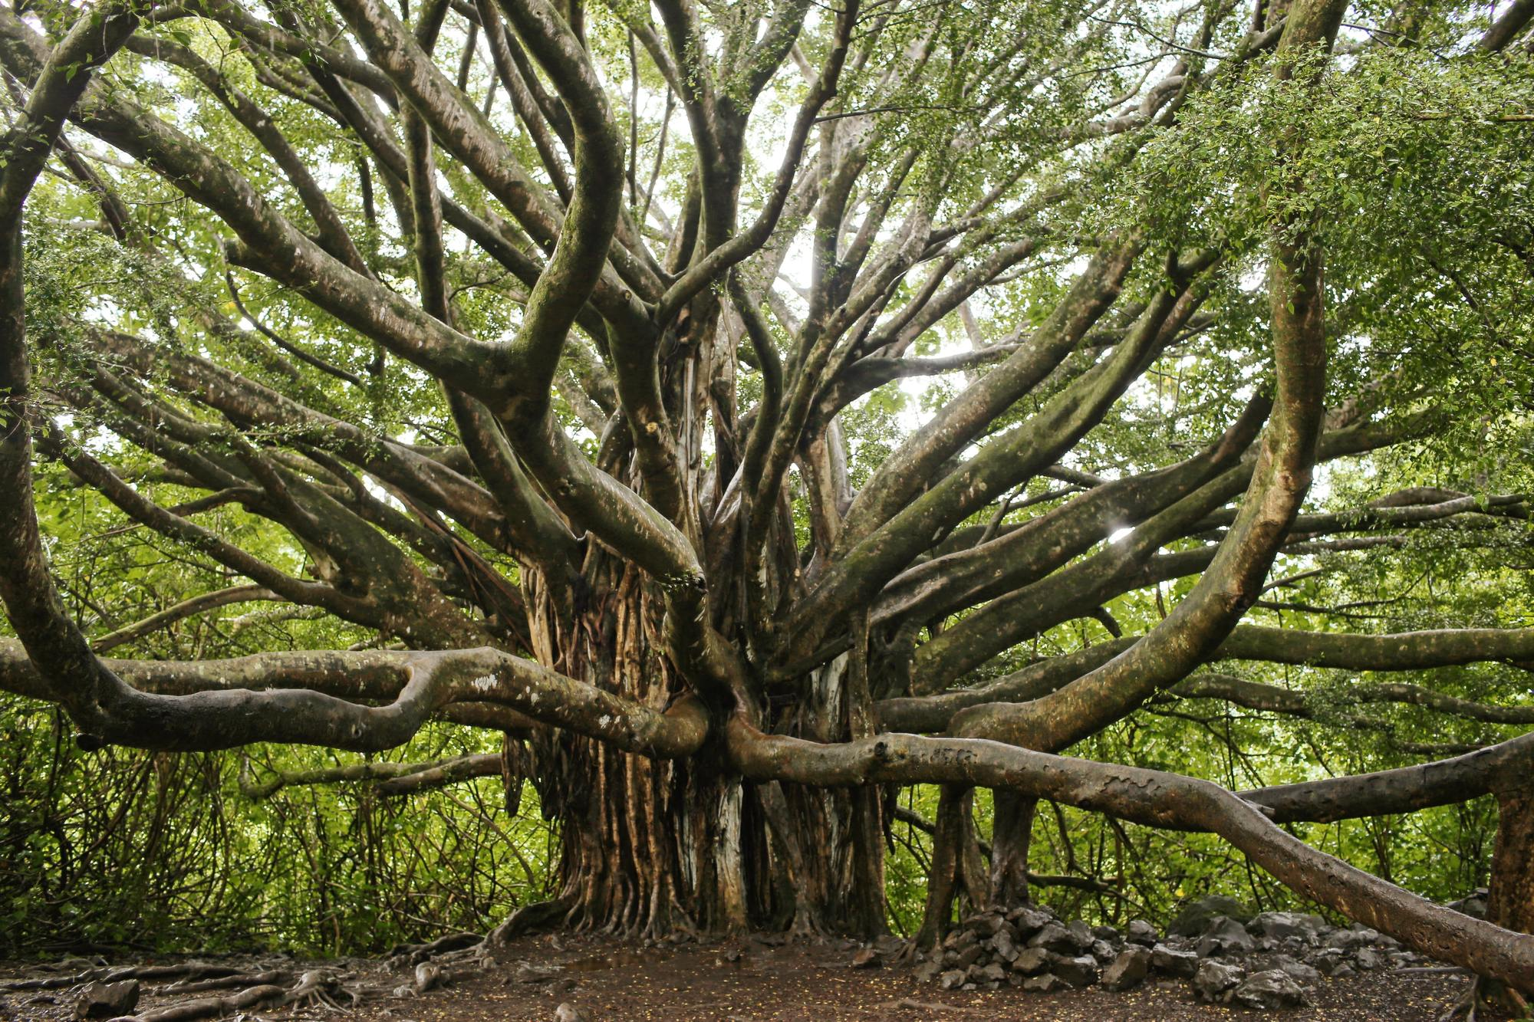
CS 201: Data Structures
Minimum Spanning Trees
Aaron Bauer
Winter 2021

Slide 2
Spanning Trees
A simple problem: Given a connected undirected graph G=(V,E), find a minimal subset of edges such that G is still connected
  A graph G2=(V,E2) such that G2 is connected and removing any edge from E2 makes G2 disconnected

Slide 3
Observations
Any solution to this problem is a tree
  Recall a tree does not need a root; just means acyclic
  For any cycle, could remove an edge and still be connected
Solution not unique unless original graph was already a tree
Problem ill-defined if original graph not connected
  So |E| ≥ |V|-1
A tree with |V| nodes has |V|-1 edges
  So every solution to the spanning tree problem has |V|-1 edges

Slide 4
Motivation
A spanning tree connects all the nodes with as few edges as possible
Example: want there to be ice-free paths between any two campus buildings—what is the minimum set of paved walks that need to be de-iced?
In most compelling uses, we have a weighted undirected graph and we want a tree of least total cost
Example: Electrical wiring for a house or wires on a computer chip
Example: A road network if you cared about asphalt cost rather than travel time
This is the minimum spanning tree problem
  Will do that next, after intuition from the simpler case

Slide 5
Two Approaches
Different algorithmic approaches to the spanning-tree problem:
Do a graph traversal (e.g., depth-first search, but any traversal will do), keeping track of edges that form a tree
Iterate through edges; add to output any edge that does not create a cycle

Slide 6
Spanning tree via DFS
spanning_tree(Graph G) {
for each node i: i.marked = false
for some node i: f(i)
}
f(Node i) {
i.marked = true
for each j adjacent to i:
if(!j.marked) {
add(i,j) to output
f(j) // DFS
}
}
Correctness: DFS reaches each node. We add one edge to connect it
to the already visited nodes. Order affects result, not correctness.
Time: O(|E|)

Slide 7
Example
Stack
f(1)
top of stack
2
1
3
7
4
6
5
Output:

Slide 8
Example
Stack
f(1)
f(2)
top
2
1
3
7
4
6
5
Output: (1,2)

Slide 9
Example
Stack
f(1)
f(2)
f(7)
top
2
1
3
7
4
6
5
Output: (1,2), (2,7)

Slide 10
Example
Stack
f(1)
f(2)
f(7)
f(5)
top
2
1
3
7
4
6
5
Output: (1,2), (2,7), (7,5)

Slide 11
Example
Stack
f(1)
f(2)
f(7)
f(5)
f(4)
top
2
1
3
7
4
6
5
Output: (1,2), (2,7), (7,5), (5,4)

Slide 12
Example
Stack
f(1)
f(2)
f(7)
f(5)
f(4)
f(3)
top
2
1
3
7
4
6
5
Output: (1,2), (2,7), (7,5), (5,4),(4,3)

Slide 13
Example
Stack
f(1)
f(2)
f(7)
f(5)
f(4) f(6)
f(3)
2
1
3
7
4
6
5
Output: (1,2), (2,7), (7,5), (5,4), (4,3), (5,6)

Slide 14
Example
Stack
f(1)
f(2)
f(7)
f(5)
f(4) f(6)
f(3)
2
1
3
7
4
6
5
Output: (1,2), (2,7), (7,5), (5,4), (4,3), (5,6)

Slide 15
Second Approach
Iterate through edges; output any edge that does not create a cycle
Correctness (hand-wavy):
  Goal is to build an acyclic connected graph
  When we add an edge, it adds a vertex to the tree
    Else it would have created a cycle
  The graph is connected, so we reach all vertices
Efficiency:
  Depends on how quickly you can detect cycles
  Reconsider after the example

Slide 16
Example
Edges in some arbitrary order:
(1,2), (3,4), (5,6), (5,7),(1,5), (1,6), (2,7), (2,3), (4,5), (4,7)
2
1
3
7
4
6
5
Output:

Slide 17
Example
Edges in some arbitrary order:
(1,2), (3,4), (5,6), (5,7),(1,5), (1,6), (2,7), (2,3), (4,5), (4,7)
2
1
3
7
4
6
5
Output: (1,2)

Slide 18
Example
Edges in some arbitrary order:
(1,2), (3,4), (5,6), (5,7),(1,5), (1,6), (2,7), (2,3), (4,5), (4,7)
2
1
3
7
4
6
5
Output: (1,2), (3,4)

Slide 19
Example
Edges in some arbitrary order:
(1,2), (3,4), (5,6), (5,7),(1,5), (1,6), (2,7), (2,3), (4,5), (4,7)
2
1
3
7
4
6
5
Output: (1,2), (3,4), (5,6),

Slide 20
Example
Edges in some arbitrary order:
(1,2), (3,4), (5,6), (5,7),(1,5), (1,6), (2,7), (2,3), (4,5), (4,7)
2
1
3
7
4
6
5
Output: (1,2), (3,4), (5,6), (5,7)

Slide 21
Example
Edges in some arbitrary order:
(1,2), (3,4), (5,6), (5,7), (1,5), (1,6), (2,7), (2,3), (4,5), (4,7)
2
1
3
7
4
6
5
Output: (1,2), (3,4), (5,6), (5,7), (1,5)

Slide 22
Example
Edges in some arbitrary order:
(1,2), (3,4), (5,6), (5,7), (1,5), (1,6), (2,7), (2,3), (4,5), (4,7)
2
1
3
7
4
6
5
Output: (1,2), (3,4), (5,6), (5,7), (1,5)

Slide 23
Example
Edges in some arbitrary order:
(1,2), (3,4), (5,6), (5,7), (1,5), (1,6), (2,7), (2,3), (4,5), (4,7)
2
1
3
7
4
6
5
Output: (1,2), (3,4), (5,6), (5,7), (1,5)

Slide 24
Example
Edges in some arbitrary order:
(1,2), (3,4), (5,6), (5,7), (1,5), (1,6), (2,7), (2,3), (4,5), (4,7)
2
1
3
7
4
6
Can stop once we
have |V|-1 edges
5
Output: (1,2), (3,4), (5,6), (5,7), (1,5), (2,3)

Slide 25
Cycle Detection
To decide if an edge could form a cycle is O(|V|) because we may need to traverse all edges already in the output
So overall algorithm would be O(|V||E|)
But there is a faster way we know: a data structure called union-find!
  All we need to know is that it efficiently keeps track of which elements are connected (can check for cycle in about O(1))
  All elements start out disconnected
  union(int a, int b) connects a and b (like an edge in a graph)
  connectedTo(int a, int b) returns whether a and b are connected (again like a graph, could be a→x→y→b)
  Read Algorithms 1.5 for the details

Slide 26
Summary So Far
The spanning-tree problem
  Add nodes to partial tree approach is O(|E|)
  Add acyclic edges approach is almost O(|E|)
    Using union-find “as a black box”
But really want to solve the minimum-spanning-tree problem
  Given a weighted undirected graph, give a spanning tree of minimum weight
  Same two approaches will work with minor modifications
  Both will be O(|E| log |V|)

Slide 27
Getting to the Point
Algorithm #1
Shortest-path is to Dijkstra’s Algorithm
as
Minimum Spanning Tree is to Prim’s Algorithm
(Both based on expanding cloud of known vertices, basically using a priority queue instead of a DFS stack)
Algorithm #2
Kruskal’s Algorithm for Minimum Spanning Tree
is
Exactly our 2nd approach to spanning tree
but process edges in cost order

Slide 28
Prim’s Algorithm Idea
Idea: Grow a tree by adding an edge from the “known” vertices to the “unknown” vertices. Pick the edge with the smallest weight that connects “known” to “unknown.”
Recall Dijkstra “picked edge with closest known distance to source”
  That is not what we want here
  Otherwise identical (!)

Slide 29
The Algorithm
For each node v, set v.cost = ∞ and v.known = false
Choose any node v
  Mark v as known
  For each edge (v,u) with weight w, set u.cost=w and u.prev=v
While there are unknown nodes in the graph
  Select the unknown node v with lowest cost
  Mark v as known and add (v, v.prev) to output
  For each edge (v,u) with weight w,
  if(w < u.cost) {
  u.cost = w;
  u.prev = v;
  }

Slide 30
Example
∞
∞
2
A
B
1
1
∞
2
5
E
∞
1
1
D
3
C
5
∞
∞
2
6
G
vertex | known? | cost | prev
A |  | ??
B |  | ??
C |  | ??
D |  | ??
E |  | ??
F |  | ??
G |  | ??
∞
10
F

Slide 31
Example
0
2
2
A
B
1
1
∞
2
5
E
1
1
1
D
3
C
5
2
∞
2
6
G
vertex | known? | cost | prev
A | Y | 0
B |  | 2 | A
C |  | 2 | A
D |  | 1 | A
E |  | ??
F |  | ??
G |  | ??
∞
10
F

Slide 32
Example
0
2
2
A
B
1
1
1
2
5
E
1
1
1
D
3
C
5
2
5
2
6
G
vertex | known? | cost | prev
A | Y | 0
B |  | 2 | A
C |  | 1 | D
D | Y | 1 | A
E |  | 1 | D
F |  | 6 | D
G |  | 5 | D
6
10
F

Slide 33
Example
0
2
2
A
B
1
1
1
2
5
E
1
1
1
D
3
C
5
2
5
2
6
G
vertex | known? | cost | prev
A | Y | 0
B |  | 2 | A
C | Y | 1 | D
D | Y | 1 | A
E |  | 1 | D
F |  | 2 | C
G |  | 5 | D
2
10
F

Slide 34
Example
0
1
2
A
B
1
1
1
2
5
E
1
1
1
D
3
C
5
2
3
2
6
G
vertex | known? | cost | prev
A | Y | 0
B |  | 1 | E
C | Y | 1 | D
D | Y | 1 | A
E | Y | 1 | D
F |  | 2 | C
G |  | 3 | E
2
10
F

Slide 35
Example
0
1
2
A
B
1
1
1
2
5
E
1
1
1
D
3
C
5
2
3
2
6
G
vertex | known? | cost | prev
A | Y | 0
B | Y | 1 | E
C | Y | 1 | D
D | Y | 1 | A
E | Y | 1 | D
F |  | 2 | C
G |  | 3 | E
2
10
F

Slide 36
Example
0
1
2
A
B
1
1
1
2
5
E
1
1
1
D
3
C
5
2
3
2
6
G
vertex | known? | cost | prev
A | Y | 0
B | Y | 1 | E
C | Y | 1 | D
D | Y | 1 | A
E | Y | 1 | D
F | Y | 2 | C
G |  | 3 | E
2
10
F

Slide 37
Example
0
1
2
A
B
1
1
1
2
5
E
1
1
1
D
3
C
5
2
3
2
6
G
vertex | known? | cost | prev
A | Y | 0
B | Y | 1 | E
C | Y | 1 | D
D | Y | 1 | A
E | Y | 1 | D
F | Y | 2 | C
G | Y | 3 | E
2
10
F

Slide 38
Analysis
Run-time
  Same as Dijkstra
  O(|E| log |V|) using a priority queue
    Costs/priorities are just edge-costs, not path-costs

Slide 39
Kruskal’s Algorithm
Idea: Grow a forest out of edges that do not grow a cycle, just like for the spanning tree problem.
  But now consider the edges in order by weight
So:
  Sort edges: O(|E|log |E|)
  Iterate through edges using union-find for cycle detection almost O(|E|)
Somewhat better:
  Floyd’s algorithm to build min-heap with edges O(|E|)
  Iterate through edges using union-find for cycle detection and deleteMin to get next edge O(|E| log |E|)
  Not better worst-case asymptotically, but often stop long before considering all edges

Slide 40
Pseudocode
Sort edges by weight (better: put in min-heap)
Union-find has each node disconnected
While output size < |V|-1
  Consider next smallest edge (u,v)
  if connectedTo(u,v) indicate u and v are disconnected
    output (u,v)
    union(u,v)
Recall invariant:
u and v in connected in union-find if and only if connected in output-so-far

Slide 41
Example
2
Edges in sorted order:
1: (A,D), (C,D), (B,E), (D,E)
2: (A,B), (C,F), (A,C)
3: (E,G)
5: (D,G), (B,D)
6: (D,F)
10: (F,G)
A
B
1
1
5
2
E
1
1
D
3
C
5
2
6
G
10
F
Output:

Slide 42
Example
2
Edges in sorted order:
1: (A,D), (C,D), (B,E), (D,E)
2: (A,B), (C,F), (A,C)
3: (E,G)
5: (D,G), (B,D)
6: (D,F)
10: (F,G)
A
B
1
1
5
2
E
1
1
D
3
C
5
2
6
G
10
F
Output: (A,D)

Slide 43
Example
2
Edges in sorted order:
1: (A,D), (C,D), (B,E), (D,E)
2: (A,B), (C,F), (A,C)
3: (E,G)
5: (D,G), (B,D)
6: (D,F)
10: (F,G)
A
B
1
1
5
2
E
1
1
D
3
C
5
2
6
G
10
F
Output: (A,D), (C,D)

Slide 44
Example
2
Edges in sorted order:
1: (A,D), (C,D), (B,E), (D,E)
2: (A,B), (C,F), (A,C)
3: (E,G)
5: (D,G), (B,D)
6: (D,F)
10: (F,G)
A
B
1
1
5
2
E
1
1
D
3
C
5
2
6
G
10
F
Output: (A,D), (C,D), (B,E)

Slide 45
Example
2
Edges in sorted order:
1: (A,D), (C,D), (B,E), (D,E)
2: (A,B), (C,F), (A,C)
3: (E,G)
5: (D,G), (B,D)
6: (D,F)
10: (F,G)
A
B
1
1
5
2
E
1
1
D
3
C
5
2
6
G
10
F
Output: (A,D), (C,D), (B,E), (D,E)

Slide 46
Example
2
Edges in sorted order:
1: (A,D), (C,D), (B,E), (D,E)
2: (A,B), (C,F), (A,C)
3: (E,G)
5: (D,G), (B,D)
6: (D,F)
10: (F,G)
A
B
1
1
5
2
E
1
1
D
3
C
5
2
6
G
10
F
Output: (A,D), (C,D), (B,E), (D,E)

Slide 47
Example
2
Edges in sorted order:
1: (A,D), (C,D), (B,E), (D,E)
2: (A,B), (C,F), (A,C)
3: (E,G)
5: (D,G), (B,D)
6: (D,F)
10: (F,G)
A
B
1
1
5
2
E
1
1
D
3
C
5
2
6
G
10
F
Output: (A,D), (C,D), (B,E), (D,E), (C,F)

Slide 48
Example
2
Edges in sorted order:
1: (A,D), (C,D), (B,E), (D,E)
2: (A,B), (C,F), (A,C)
3: (E,G)
5: (D,G), (B,D)
6: (D,F)
10: (F,G)
A
B
1
1
5
2
E
1
1
D
3
C
5
2
6
G
10
F
Output: (A,D), (C,D), (B,E), (D,E), (C,F)

Slide 49
Example
2
Edges in sorted order:
1: (A,D), (C,D), (B,E), (D,E)
2: (A,B), (C,F), (A,C)
3: (E,G)
5: (D,G), (B,D)
6: (D,F)
10: (F,G)
A
B
1
1
5
2
E
1
1
D
3
C
5
2
6
G
10
F
Output: (A,D), (C,D), (B,E), (D,E), (C,F), (E,G)

