Slide 1
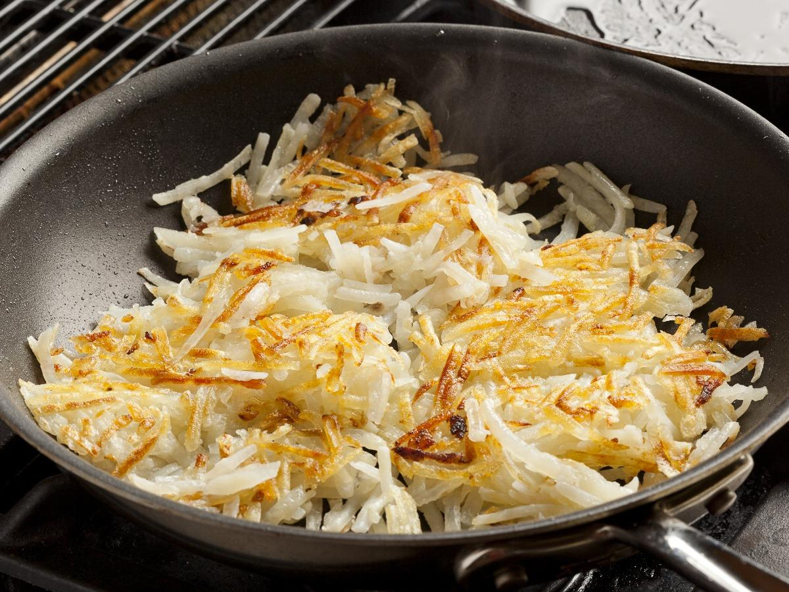
CS 201: Data Structures
Hashing I
Aaron Bauer
Winter 2021

Slide 2
Motivating Hash Tables
For a Map with n key, value pairs
        put contains remove
Unsorted linked-list O(n) O(n) O(n)
Unsorted array O(n) O(n) O(n)
Sorted linked list O(n) O(n) O(n)
Sorted array O(n) O(log n) O(n)
Balanced tree O(log n) O(log n) O(log n)
Magic array O(1) O(1) O(1)
Sufficient “magic”:
  Remove the requirement that elements are ordered [easy]
  Use key to compute array index for an item in O(1) time [doable]
  Have a different index for every item [magic]
Notes:
LL: O(1), O(n), O(n)
Uns: O(1), O(n), O(n)
Sorted: O(n), O(log n), O(n)
Sorted array is oh-so-close. O(log n) find time and almost O(log n) insert time. What’s wrong?
Let’s look at how that search goes:
Draw recursive calls (and potential recursive calls) in binary search.
Note how it starts looking like a binary tree where the left subtrees have smaller elements and the right subtrees have bigger elements.
What if we could store the whole thing in the structure this recursive search is building?

Slide 3
Hash Tables: Turn Key Into Array Index
Aim for constant time put, get, contains, and remove
  “On average” under some often-reasonable assumptions
A hash table is an array of some fixed size
Basic idea:
hash table
0
 | …
hash function:
index = h(key)
All possible keys
(e.g., integers, strings)
TableSize –1

Slide 4
Hash Tables vs. Balanced Trees
In terms of a Dictionary ADT for just insert, find, delete, hash tables and balanced trees are just different data structures
  Hash tables O(1) on average (assuming few collisions)
  Balanced trees O(log n) worst-case
Constant-time is better, right?
  Yes, but you need “hashing to behave” (must avoid collisions)
  Yes, but findMin, findMax, predecessor, and successor go from O(log n) to O(n), printSorted from O(n) to O(n log n)
    Why your textbook considers this to be a different ADT

Slide 5
Hash Tables: More Keys Than Spots
There are m possible keys (m typically large, even infinite)
We expect our table to have only n items
n is much less than m (often written n << m)
Many maps have this property
  Compiler: All possible identifiers allowed by the language vs. those used in some file of one program
  Database: All possible volunteer names vs. volunteers signed up with Bauer for MN
  AI: All possible chess-board configurations vs. those considered by the current player
  …

Slide 6
Hash functions
An ideal hash function:
Fast to compute
“Rarely” hashes two “used” keys to the same index
  Often impossible in theory but easy in practice
  Will handle collisions in next lesson
hash table
0
 | …
hash function:
index = h(key)
All possible keys
(e.g., integers, strings)
TableSize –1

Slide 7
Hashing integers
key space = integers
Simple hash function:
  h(key) = key % TableSize
  Fairly fast and natural
Example:
  TableSize = 10
  Insert 7, 18, 41, 34, 10
  (ignoring the values of these key-value pairs—we’ll think of these as data “along for the ride”)
0
1
2
3
4
5
6
7
8
9

Slide 8
Hashing integers
key space = integers
Simple hash function:
  h(key) = key % TableSize
  Fairly fast and natural
Example:
  TableSize = 10
  Insert 7, 18, 41, 34, 10
  (As usual, ignoring data “along for the ride”)
0
1
2
3
4
5
6
7 | 7
8
9

Slide 9
Hashing integers
key space = integers
Simple hash function:
  h(key) = key % TableSize
  Fairly fast and natural
Example:
  TableSize = 10
  Insert 7, 18, 41, 34, 10
  (As usual, ignoring data “along for the ride”)
0
1
2
3
4
5
6
7 | 7
8 | 18
9

Slide 10
Hashing integers
key space = integers
Simple hash function:
  h(key) = key % TableSize
  Fairly fast and natural
Example:
  TableSize = 10
  Insert 7, 18, 41, 34, 10
  (As usual, ignoring data “along for the ride”)
0
1 | 41
2
3
4
5
6
7 | 7
8 | 18
9

Slide 11
Hashing integers
key space = integers
Simple hash function:
  h(key) = key % TableSize
  Fairly fast and natural
Example:
  TableSize = 10
  Insert 7, 18, 41, 34, 10
  (As usual, ignoring data “along for the ride”)
0
1 | 41
2
3
4 | 34
5
6
7 | 7
8 | 18
9

Slide 12
Hashing integers
key space = integers
Simple hash function:
  h(key) = key % TableSize
  Fairly fast and natural
Example:
  TableSize = 10
  Insert 7, 18, 41, 34, 10
  (As usual, ignoring data “along for the ride”)
0 | 10
1 | 41
2
3
4 | 34
5
6
7 | 7
8 | 18
9

Slide 13
Who hashes what?
Hash tables can be generic
  To store elements of type E, we just need E to be:
    Hashable: convert any E to an int
When hash tables are a reusable library (as they are in Java), the division of responsibility generally breaks down into two roles:
client
hash table library
collision?
collision
resolution
E
int
table-index
We will learn both roles, but most programmers “in the real world” spend more time as clients while understanding the library

Slide 14
More on roles
Some ambiguity in terminology on which parts are “hashing”
client
hash table library
collision?
collision
resolution
E
int
table-index
“hashing”?
“hashing”?
Two roles must both contribute to minimizing collisions (heuristically)
Client should aim for different ints for expected items
Library should aim for putting “similar” ints in different indices
  Conversion to index is almost always “mod table-size”
  Using prime numbers for table-size is common

Slide 15
Okay, what about keys that aren’t ints?
If keys aren’t ints, the client must convert to an int
  Trade-off: speed versus distinct keys hashing to distinct ints
Very important example: Strings
  Key space K = s₀s₁s₂…s_{m-1}
    (where s_{i} are chars: between 0 to 65,535, inclusive)
  Some choices: Which avoid collisions best?
  h(K) = s₀ % TableSize
  h(K) = (s₀ + s₁ + … s_{m-1}) % TableSize
  h(K) = (s₀ + s₁ * 31 + s₂ * 31² + … s_{m-1} * 31^{m-1}) % TableSize
    (I’ll demonstrate this is what Java does)

Slide 16
Specializing hash functions
How might you hash differently if all your strings were web addresses (URLs)?

Slide 17
Hashing and comparing
Need to emphasize a critical detail:
  We initially hash key E to get a table index
  To confirm that index has what we’re looking for we check if our key equals the key stored at that index
So a hash table needs a hash function and a way to compare keys
  The Java library uses an object-oriented approach:
  each object has methods equals and hashCode
    class Object {
    boolean equals(Object o) {…}
    int hashCode() {…}
    …
    }

Slide 18
Equal Objects Must Hash the Same
The Java library make a crucial assumption clients must satisfy
  And all hash tables make analogous assumptions
Object-oriented way of saying it:
  If a.equals(b), then a.hashCode() == b.hashCode()
Why is this essential?
  Necessary in order for correct hash table behavior
Why is this up to the client?
  Both methods depend on private fields, so library can’t do it
So always override hashCode correctly if you override equals
  Many libraries use hash tables on your objects

Slide 19
Example
CalendarDate.java in VS Code

Slide 20
Tougher example
Suppose you had a Fraction class where equals returned true for 1/2 and 3/6, etc.
Then must override hashCode and cannot hash just based on the numerator and denominator
  Need 1/2 and 3/6 to hash to the same int
If you write software for a living, you are less likely to implement hash tables from scratch than you are likely to encounter this issue

Slide 21
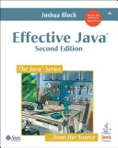
One expert suggestion
int result = 17;
for-each field f
  int fieldHashcode =
    boolean: (f ? 1: 0)
    byte, char, short, int: (int) f
    long: (int) (f ^ (f >>> 32))
    float: Float.floatToIntBits(f)
    double: Double.doubleToLongBits(f), then as long above
    Object: object.hashCode( )
  result = 31 * result + fieldHashcode

Slide 22
Conclusions and notes on hashing
The hash table is one of the most important data structures
  Supports contains, put, get and remove efficiently (constant time!)
  We can iterate over the keys and/or values, but they are not guaranteed to be in any particular order
Important to use a good hash function
Side-comment: hash functions have uses beyond hash tables
  Examples: Cryptography, check-sums
Big remaining topic: Handling collisions

