Slide 1
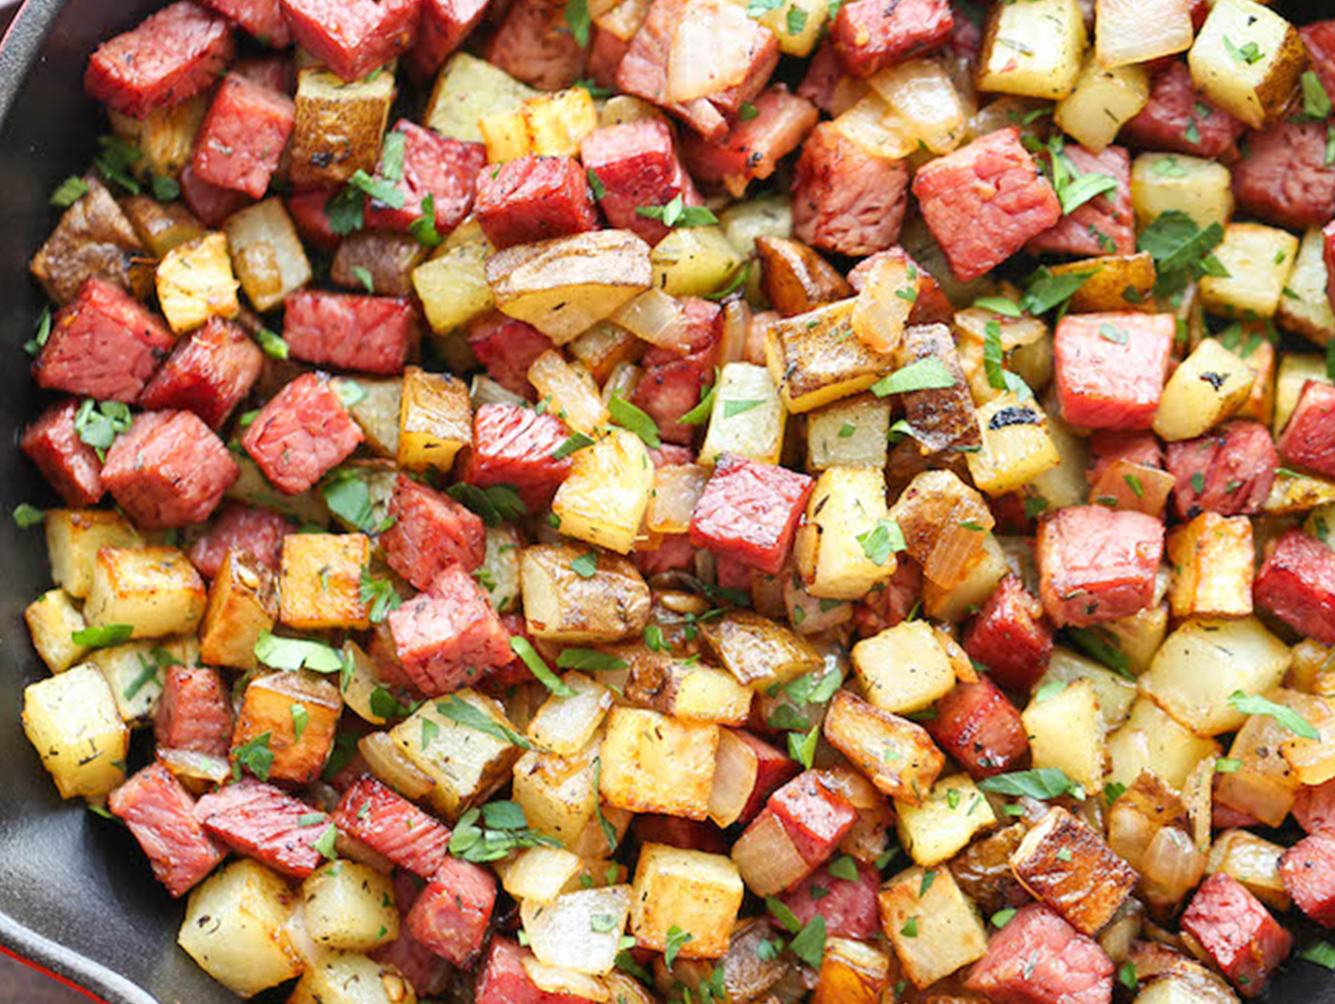
CS 201: Data Structures
Hashing II
Aaron Bauer
Winter 2021

Slide 2
Hash Tables: Review
Aim for constant-time put, contains, and remove
  “On average” under some reasonable assumptions
A hash table is an array of some fixed size
  But extensible as we’ll see
hash table
0
 | …
client
hash table library
collision?
collision
resolution
E
int
table-index
TableSize –1

Slide 3
Collision resolution
Collision:
When two keys map to the same location in the hash table
We try to avoid it, but number-of-keys exceeds table size
So hash tables should support collision resolution

Slide 4
Collision-avoidance
With “x % TableSize” the number of collisions depends on
  the ints inserted (obviously)
  TableSize
Larger table-size tends to help, but not always
  Example: 70, 24, 56, 43, 10
  with TableSize = 10 and TableSize = 60
Technique: Pick table size to be prime. Why?
  Real-life data tends to have a pattern
  “Multiples of 61” are probably less likely than “multiples of 60”

Slide 5
More on prime table size
If TableSize is 60 and…
  Lots of keys hash to multiples of 5, wasting 80% of table
  Lots of keys hash to multiples of 10, wasting 90% of table
  Lots of keys hash to multiples of 2, wasting 50% of table
If TableSize is 61…
  Collisions can still happen, but 5, 10, 15, 20, … will fill table
  Collisions can still happen but 10, 20, 30, 40, … will fill table
  Collisions can still happen but 2, 4, 6, 8, … will fill table
This “table-filling” property happens whenever the multiple and the table-size have a greatest-common-divisor of 1

Slide 6
Handling Collisions: Separate Chaining
0 | /
1 | /
2 | /
3 | /
4 | /
5 | /
6 | /
7 | /
8 | /
9 | /
10 | /
Chaining:
All keys that map to the same
table location are kept in a linked list
(a.k.a. a “chain” or “bucket”)
As easy as it sounds
Example:
insert 11, 24, 106, 13, 46
with mod hashing
and TableSize = 11

Slide 7
Handling Collisions: Separate Chaining
0
1 | /
2 | /
3 | /
4 | /
5 | /
6 | /
7 | /
8 | /
9 | /
10 | /
Chaining:
All keys that map to the same
table location are kept in a linked list (a.k.a. a “chain” or “bucket”)
As easy as it sounds
Example:
insert 11, 24, 106, 13, 46
with mod hashing
and TableSize = 11
11
/

Slide 8
Handling Collisions: Separate Chaining
0
1 | /
2
3 | /
4 | /
5 | /
6 | /
7 | /
8 | /
9 | /
10 | /
Chaining:
All keys that map to the same
table location are kept in a linked list (a.k.a. a “chain” or “bucket”)
As easy as it sounds
Example:
insert 11, 24, 106, 13, 46
with mod hashing
and TableSize = 11
11
/
24
/

Slide 9
Handling Collisions: Separate Chaining
0
1 | /
2
3 | /
4 | /
5 | /
6 | /
7
8 | /
9 | /
10 | /
Chaining:
All keys that map to the same
table location are kept in a linked list (a.k.a. a “chain” or “bucket”)
As easy as it sounds
Example:
insert 11, 24, 106, 13, 46
with mod hashing
and TableSize = 11
11
/
24
/
106
/

Slide 10
Handling Collisions: Separate Chaining
0
1 | /
2
3 | /
4 | /
5 | /
6 | /
7
8 | /
9 | /
10 | /
Chaining:
All keys that map to the same
table location are kept in a linked list (a.k.a. a “chain” or “bucket”)
As easy as it sounds
Example:
insert 11, 24, 106, 13, 46
with mod hashing
and TableSize = 11
11
/
13
24
/
106
/

Slide 11
Handling Collisions: Separate Chaining
0
1 | /
2
3 | /
4 | /
5 | /
6 | /
7
8 | /
9 | /
10 | /
Chaining:
All keys that map to the same
table location are kept in a linked list (a.k.a. a “chain” or “bucket”)
As easy as it sounds
Example:
insert 11, 24, 106, 13, 46
with mod hashing
and TableSize = 11
11
/
46
13
24
/
106
/

Slide 12
Thoughts on chaining
Worst-case time for contains?
  Linear
  But only with really bad luck or bad hash function
  So not worth doing extra work to avoid this worst case
Beyond asymptotic complexity, some “data-structure engineering” may be warranted
  Linked list vs. array vs. chunked list (lists should be short!)
  Move-to-front
  Maybe leave room for 1 element (or 2?) in the table itself, to optimize constant factors for the common case
    A time-space trade-off…

Slide 13
Time vs. space (constant factors only here)
0
1 | /
2
3 | /
4 | /
5 | /
6 | /
7
8 | /
9 | /
10 | /
0 | 11 | /
1 | / | X
2 | 46
3 | / | X
4 | / | X
5 | / | X
6 | / | X
7 | 106 | /
8 | / | X
9 | / | X
10 | / | X
11
/
46
13
24
/
13
24
/
106
/

Slide 14
More rigorous chaining analysis
Definition: The load factor, λ, of a hash table is
← number of elements
Under chaining, the average number of elements per bucket is ___

Slide 15
More rigorous chaining analysis
Definition: The load factor, λ, of a hash table is
← number of elements
Under chaining, the average number of elements per bucket is λ
So if some puts are followed by random contains, then on average:
Each unsuccessful contains compares against ____ items

Slide 16
More rigorous chaining analysis
Definition: The load factor, λ, of a hash table is
← number of elements
Under chaining, the average number of elements per bucket is λ
So if some puts are followed by random contains, then on average:
Each unsuccessful contains compares against λ items
Each successful contains compares against _____ items

Slide 17
More rigorous chaining analysis
Definition: The load factor, λ, of a hash table is
← number of elements
Under chaining, the average number of elements per bucket is λ
So if some puts are followed by random contains, then on average:
Each unsuccessful contains compares against λ items
Each successful contains compares against λ / 2 items
So we like to keep λ fairly low (e.g., 1 or 1.5 or 2) for chaining

Slide 18
Alternative: Use empty space in the table
Another simple idea: If h(key) is already full,
  try (h(key) + 1) % TableSize. If full,
  try (h(key) + 2) % TableSize. If full,
  try (h(key) + 3) % TableSize. If full…
Example: insert 38, 19, 8, 109, 10
0 | /
1 | /
2 | /
3 | /
4 | /
5 | /
6 | /
7 | /
8 | 38
9 | /

Slide 19
Alternative: Use empty space in the table
Another simple idea: If h(key) is already full,
  try (h(key) + 1) % TableSize. If full,
  try (h(key) + 2) % TableSize. If full,
  try (h(key) + 3) % TableSize. If full…
Example: insert 38, 19, 8, 109, 10
0 | /
1 | /
2 | /
3 | /
4 | /
5 | /
6 | /
7 | /
8 | 38
9 | 19

Slide 20
Alternative: Use empty space in the table
Another simple idea: If h(key) is already full,
  try (h(key) + 1) % TableSize. If full,
  try (h(key) + 2) % TableSize. If full,
  try (h(key) + 3) % TableSize. If full…
Example: insert 38, 19, 8, 109, 10
0 | 8
1 | /
2 | /
3 | /
4 | /
5 | /
6 | /
7 | /
8 | 38
9 | 19

Slide 21
Alternative: Use empty space in the table
Another simple idea: If h(key) is already full,
  try (h(key) + 1) % TableSize. If full,
  try (h(key) + 2) % TableSize. If full,
  try (h(key) + 3) % TableSize. If full…
Example: insert 38, 19, 8, 109, 10
0 | 8
1 | 109
2 | /
3 | /
4 | /
5 | /
6 | /
7 | /
8 | 38
9 | 19

Slide 22
Alternative: Use empty space in the table
Another simple idea: If h(key) is already full,
  try (h(key) + 1) % TableSize. If full,
  try (h(key) + 2) % TableSize. If full,
  try (h(key) + 3) % TableSize. If full…
Example: insert 38, 19, 8, 109, 10
0 | 8
1 | 109
2 | 10
3 | /
4 | /
5 | /
6 | /
7 | /
8 | 38
9 | 19

Slide 23
Probing hash tables
Trying the next spot is called probing (also called open addressing)
  We just did linear probing
    i^{th} probe was (h(key) + i) % TableSize
Open addressing does poorly with high load factor λ
  So want larger tables
  Too many probes means no more O(1)

Slide 24
Other operations
put finds an open table position using a probe function
What about contains?
  Must use same probe function to “retrace the trail” for the data
  Unsuccessful search when reach empty position
What about remove?
  Must use “lazy” deletion. Why?
    Marker indicates “no data here, but don’t stop probing”
  Note: remove with chaining is plain-old list-remove

Slide 25
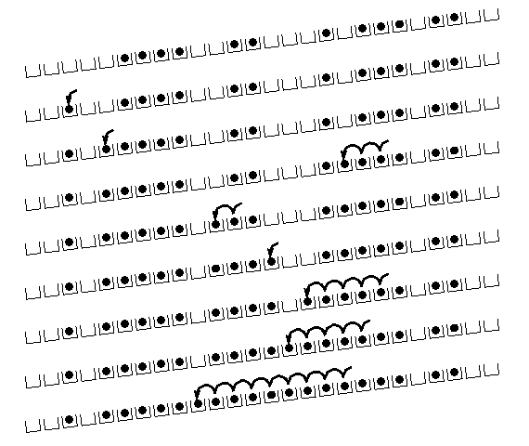
(Primary) Clustering
It turns out linear probing is a bad idea, even though the probe function is quick to compute (which is a good thing)
Tends to produce
clusters, which lead to
long probing sequences
Called primary clustering
Saw this starting in our example
[R. Sedgewick]

Slide 26
Analysis of Linear Probing
Trivial fact: For any λ < 1, linear probing will find an empty slot
  It is “safe” in this sense: no infinite loop unless table is full
Non-trivial facts we won’t prove:
Average # of probes given λ (in the limit as TableSize →∞ )
  Unsuccessful search:
  Successful search:
This is pretty bad: need to leave sufficient empty space in the table to get decent performance (see chart)

Slide 27
Analysis of Linear Probing
For any λ < 1, linear probing will find an empty slot
  It is “safe” in this sense: no infinite loop unless table is full
Linear-probing performance degrades rapidly as table gets full
By comparison, chaining performance is linear in λ and has no trouble with λ>1

Slide 28
Quadratic probing
We can avoid primary clustering by changing the probe function
(h(key) + f(i)) % TableSize
A common technique is quadratic probing:
  f(i) = i²
  So probe sequence is:
    0th probe: h(key) % TableSize
    1st probe: (h(key) + 1) % TableSize
    2nd probe: (h(key) + 4) % TableSize
    3rd probe: (h(key) + 9) % TableSize
    …
    i^{th} probe: (h(key) + i²) % TableSize
Intuition: Probes quickly “leave the neighborhood”

Slide 29
Quadratic Probing Example
0
1
2
3
4
5
6
7
8
9
TableSize=10
Insert:
89
18
49
58
79

Slide 30
Quadratic Probing Example
0
1
2
3
4
5
6
7
8
9 | 89
TableSize=10
Insert:
89
18
49
58
79

Slide 31
Quadratic Probing Example
0
1
2
3
4
5
6
7
8 | 18
9 | 89
TableSize=10
Insert:
89
18
49
58
79

Slide 32
Quadratic Probing Example
0 | 49
1
2
3
4
5
6
7
8 | 18
9 | 89
TableSize=10
Insert:
89
18
49
58
79

Slide 33
Quadratic Probing Example
0 | 49
1
2 | 58
3
4
5
6
7
8 | 18
9 | 89
TableSize=10
Insert:
89
18
49
58
79

Slide 34
Quadratic Probing Example
0 | 49
1
2 | 58
3 | 79
4
5
6
7
8 | 18
9 | 89
TableSize=10
Insert:
89
18
49
58
79

Slide 35
Another Quadratic Probing Example
TableSize = 7
Insert:
(76 % 7 = 6)
(40 % 7 = 5)
48 (48 % 7 = 6)
5 ( 5 % 7 = 5)
55 (55 % 7 = 6)
47 (47 % 7 = 5)
0
1
2
3
4
5
6

Slide 36
Another Quadratic Probing Example
TableSize = 7
Insert:
(76 % 7 = 6)
(40 % 7 = 5)
48 (48 % 7 = 6)
5 ( 5 % 7 = 5)
55 (55 % 7 = 6)
47 (47 % 7 = 5)
0
1
2
3
4
5
6 | 76

Slide 37
Another Quadratic Probing Example
TableSize = 7
Insert:
(76 % 7 = 6)
(40 % 7 = 5)
48 (48 % 7 = 6)
5 ( 5 % 7 = 5)
55 (55 % 7 = 6)
47 (47 % 7 = 5)
0
1
2
3
4
5 | 40
6 | 76

Slide 38
Another Quadratic Probing Example
TableSize = 7
Insert:
(76 % 7 = 6)
(40 % 7 = 5)
48 (48 % 7 = 6)
5 ( 5 % 7 = 5)
55 (55 % 7 = 6)
47 (47 % 7 = 5)
0 | 48
1
2
3
4
5 | 40
6 | 76

Slide 39
Another Quadratic Probing Example
TableSize = 7
Insert:
(76 % 7 = 6)
(40 % 7 = 5)
48 (48 % 7 = 6)
5 ( 5 % 7 = 5)
55 (55 % 7 = 6)
47 (47 % 7 = 5)
0 | 48
1
2 | 5
3
4
5 | 40
6 | 76

Slide 40
Another Quadratic Probing Example
TableSize = 7
Insert:
(76 % 7 = 6)
(40 % 7 = 5)
48 (48 % 7 = 6)
5 ( 5 % 7 = 5)
55 (55 % 7 = 6)
47 (47 % 7 = 5)
0 | 48
1
2 | 5
3 | 55
4
5 | 40
6 | 76

Slide 41
Another Quadratic Probing Example
TableSize = 7
Insert:
(76 % 7 = 6)
(40 % 7 = 5)
48 (48 % 7 = 6)
5 ( 5 % 7 = 5)
55 (55 % 7 = 6)
47 (47 % 7 = 5)
0 | 48
1
2 | 5
3 | 55
4
5 | 40
6 | 76
Oh nooooo!: For all n, ((n*n) +5) % 7 is 0, 2, 5, or 6

Slide 42
From Bad News to Good News
Bad news:
  Quadratic probing can cycle through the same full indices, never terminating despite table not being full
Good news:
  If TableSize is prime and λ < ½, then quadratic probing will find an empty slot in at most TableSize/2 probes
  So: If you keep λ < ½ and TableSize is prime, no need to detect cycles

Slide 43
Clustering reconsidered
Quadratic probing does not suffer from primary clustering: no problem with keys initially hashing to the same neighborhood
But it’s no help if keys initially hash to the same index
  Called secondary clustering
Can avoid secondary clustering with a probe function that depends on the key: double hashing…

Slide 44
Double hashing
Idea:
  Given two good hash functions h and g, it is very unlikely that for some key, h(key) == g(key)
  So make the probe function f(i) = i*g(key)
Probe sequence:
    0th probe: h(key) % TableSize
    1st probe: (h(key) + g(key)) % TableSize
    2nd probe: (h(key) + 2*g(key)) % TableSize
    3rd probe: (h(key) + 3*g(key)) % TableSize
    …
    i^{th} probe: (h(key) + i*g(key)) % TableSize
Detail: Make sure g(key) cannot be 0

Slide 45
Double-hashing analysis
Intuition: Because each probe is “jumping” by g(key) each time, we “leave the neighborhood” and “go different places from other initial collisions”
But we could still have a problem like in quadratic probing where we are not “safe” (infinite loop despite room in table)
  It is known that this cannot happen in at least one case:
    h(key) = key % p
    g(key) = q – (key % q)
    2 < q < p
    p and q are prime

Slide 46
More double-hashing facts
Assume “uniform hashing”
  Means probability of g(key1) % p == g(key2) % p is 1/p
Non-trivial facts we won’t prove:
Average # of probes given λ (in the limit as TableSize →∞ )
  Unsuccessful search (intuitive):
  Successful search (less intuitive):
Bottom line: unsuccessful bad (but not as bad as linear probing), but successful is not nearly as bad

Slide 47
Charts

Slide 48
Rehashing
As with array-based stacks/queues/lists, if table gets too full, create a bigger table and copy everything
  Re-apply the hash function to find the next index for each key
With chaining, we get to decide what “too full” means
  Keep load factor reasonable (e.g., < 1)?
  Consider average or max size of non-empty chains?
For probing, half-full is a good rule of thumb
New table size
  Twice-as-big is a good idea, except that won’t be prime!
  So go about twice-as-big
  Can have a list of prime numbers in your code since you won’t grow more than 20-30 times

